Slide 1
Chapter 4
Managing and Pricing Deposit Services
6-7人设计一个同类存款账户affinity deposits。同类存款只会发生在存款的竞争白热化的时候，课堂展示文案+PPT10分钟的银行的创意搜集会每个人都要讲，在利率完全市场化的情况下，对存款定价？客户群体(对市场细分！)

Slide 2
4.1 Types of Deposits Offered by Banks
4.2 Interest Rates Offered on Different Types of Deposits
4.3 Composition of Bank Deposits
4.4 Innovations in the Deposit Market会说很多
4.5 Pricing deposit-related services

Slide 3
4.1 Types of Deposits Offered by Banks
Transaction (Payments) Deposits
The transaction (demand) deposit service requires the bank to honor immediately any withdrawals made either in person by the customer or by a third party designated by the customer to be the recipient of the funds withdrawn.
交易类存款（支付类）
非交易类存款

Slide 4
Transaction (Payments) Deposits
Noninterest-bearing Demand Deposits
(Regular checking accounts一般支票账户)
Interest-bearing Demand Deposits

Slide 5
Interest-bearing Demand Deposits
-NOW accounts
-ATs
-MMDAs
-SNOWs

Slide 6
NOWs
It stands for negotiable order of withdrawal accounts. NOWs are interest-bearing savings deposits that give the bank the right to insist on prior notice before the customer withdraws funds. The NOW can be used just like a checking account to pay for purchases of goods and services. But they can be held only by individuals and nonprofit institutions.
NOWs和Checking Account的区别：Cheque是取款的order。美国在1970年规定对Checking Account不给利息，但NOWs给利息，规避了风险

Slide 7
ATs
It stands for automatic transfers which permit the customer to preauthorize a bank to move funds from a savings account to a checking account in order to cover overdrafts.
这里Savings Account给利息，银行让客户开两个账户，C:$1,S:1%rate，如果要付$50,从S转到C付钱。

Slide 8
MMDAs
MMDAs are money market deposit accounts that are short-maturity deposits and the bank can pay any interest rate that is competitive enough to attract and hold the customer’s deposit. Up to six preauthorized drafts per month are allowed, but only three withdrawals may be made by writing checks.
这里银行可以给任意高的利率，

Slide 9
SNOWs
It stands for super negotiable order of withdrawals. The number of checks the depositor may write is not limited by regulation. They can be held only by individuals and nonprofit institutions.

Slide 10
Non-transaction (Savings,or Thrift) Deposits
  Passbook savings deposits存折
  Statement savings deposits报告单存款
  Time deposits
  Individual retirement account雇主一般给雇员开这种账户
  Keogh plan是上一种账户的另一种形式,自由职业者
  作业：梳理中国目前银行的存款业务种类(第9周交) 1995年法定商业银行后开办了各种存款类型
  “对公”

Slide 11
4.2 Interest Rates Offered on Different Types of deposits市场利率自由化，very importent
-The longer the maturity of a deposit, the greater the yield that must be offered to depositors, because of the time value of money and the frequent upward slope of the yield curve.
-The size and perceived risk exposure of the offering banks also play an important role in shaping deposit interest rates.
-Other key factors are the marketing philosophy and goals of the offering bank.
如果银行想要扩大市场份额，利率会上升

Slide 12
4.3 Composition of Bank Deposits
Factors that decide the types of deposits held by a bank:
-The public’s demand for deposit services
-Bank fund-raising policies

Slide 13
Core Deposits
A stable base of deposited funds that is not highly sensitive to movements in market interest rates and tends to remain with the bank.
由于bus principle，checking account是core deposits

Slide 14
Composition of Bank Deposits in the US
-The dominant holder of bank deposits is the private sector.
-Commercial banks also hold small amounts of US government deposits.
-Another substantial size is the deposits held by foreign governments, businesses, and individuals.
-The final major category is deposits of other banks, which include correspondent deposits.

Slide 15
4.4 Innovations in the Deposit Market
Index CDs: the new deposit instruments give the customer an option to score exceptional earnings when stock prices or commodity prices change but an option to lose all or most of their earnings if stock and commodity prices move the wrong way.

Slide 16
Bull Index CDs牛单指数存单
The depositors holding these CDs could score an exceptional gain only if stock prices rose.
假设1month的4%bull CD,如果道琼斯工业指数涨了1%,那么实际利率会是5%,反之会是3%,最大跌幅-5%
还有一个participation rate = 70%,那么4%-1%*70%=3.7%
Bear Index CDs
The depositors holding these CDs could pay off handsomely only if stock prices fell.

Slide 17
Brokered Deposits
Security brokers pool the funds of their customers and then place those funds in deposits at banks promising the highest interest rates .
Pool the funds吸收了风险

Slide 18
Special CDs and Affinity Accounts
fee-waiver CDs没有fee对于这个CD
rate-adjusted CDs利率是浮动的
deferred-interest CDs实行payroll deduction??是什么？因为更高的收入意味着更高的税收，所以客户想要利率变少一点来避税
installment CDs零存整取或整存领取
rising-rate CDs
affinity deposits同类存款账户 fans:在银行卡上有姚明的图片和签名，如果存钱就有机会看球，那我就会开通这个卡

Slide 19
Investment Accounts
Faced with huge amounts of withdrawals from bank deposit accounts, bankers responded by offering such new, high-yield savings instruments as investments in mutual funds (managed by banks themselves or by other firms ) and annuity plans. Banks earn fees from selling these investments and also earn management fees from any mutual funds or annuity accounts they manage themselves.

Slide 20
4.5 Pricing deposit-related services
A commercial bank needs to pay a high enough interest return to customers to attract and hold their deposits, but must avoid paying an interest rate that is so costly it erodes any potential profit margin from using deposited funds. Often bank managers must choose between growth成长意味着扩大市场 and profitability.

Slide 21
- Pricing Deposits at Cost Plus Profit Margin
- Using Marginal Cost to Set Interest Rates on Deposits
- Market-Penetration Deposit Pricing
- Establishing Price Schedules to Segment Deposit Customers存款费用表法
- Using Upscale Target Pricing上层目标法
- Pricing Deposits Based on the Total Customer Relationship全面客户关系定价
Using Deposit Pricing to Achieve Bank Goals
为什么要对deposits定价？

Slide 22
Pricing Deposits at Cost Plus Profit Margin
The idea of charging the customer for the total cost of deposit services has not been universally accepted in banking. A lot of banks often choose to enter a new deposit market through below-cost pricing. Customer charges are set below the true level of operating and overhead costs. The result is a substantially increased rate of return to the customer, known as the implicit interest rate – the difference between the true cost of supplying deposit services and the service charges actually assessed the customer.

Slide 23
In the United States, variations in the implicit interest rate paid to the customer were the principal way most banks competed for deposits over a period of 50 years stretching from the Great Depression to the beginning of the 1980s. But such forms of non-price competition tended to distort the allocation of scarce resources in the banking sector. So the authorities called for a gradual phase-out of deposit rate ceilings.
隐形利息使得资源配置扭曲竞争了，所以要利率市场化

Slide 24
The Cost-plus-profit-margin Deposit Pricing Formula
Unit price charged the customer for each deposit service是对存款服务的定价：包含给出的利率+服务的定价 = Operating expense per unit of deposit service + Estimated overhead expense allocated to the bank’s deposit function + Planned profit from each deposit service unit sold

Slide 25
In the U. S., more and more banks are now levying fees for excessive withdrawals from savings deposits太多的取款银行要收费, charging for customer balance inquiries老是问银行我还剩多少钱, increasing fees on bounced checks你给个拒付支票让银行无用功 and stop-payment orders, assessing charges on cash withdrawals and balance inquires made through ATMs, charging monthly maintenance fees even on small savings deposits对小额存款账户收取按月维护费, and raising required minimum deposit balances.

Slide 26
Estimating Average Deposit Service Costs
To calculate cost rate of each source of bank funds (adjusted for reserves required by the central bank, deposit insurance fees, and float).
To multiply each cost rate by the relative proportion of bank funds coming from that particular source某一种存款占总存款的比重作为权重
To sum all resulting products to derive the weighted average cost of bank funds.

Slide 27
An Example of Pooled-Funds Costing
Suppose a bank has raised a total of $400 million, including $100million in checkable deposits, $200 million in time and savings deposits, $50 million borrowed from the money market, and $50 million from its owners in the form of equity capital. Suppose that interest and non-interest costs spent to attract the checkable deposits total 10 percent of the amount of these deposits, while thrift deposits and money market borrowings each cost the bank 11 percent of funds raised in interest and non-interest expenses. Assume that equity capital costs the bank an estimated 22 percent of any new equity raised.

Slide 28
Suppose reserve requirements, deposit insurance fees, and uncollected balances (float) reduce the amount of money actually available to the bank for investing in interest-bearing assets by 15 percent for checkbook deposits, 5 percent for thrift deposits, and 2 percent for borrowings in the money market.

Slide 29
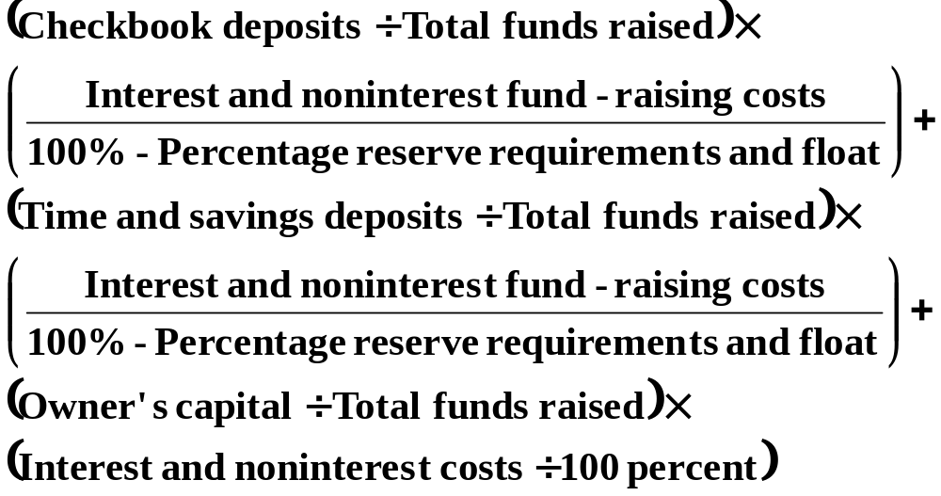

Slide 30
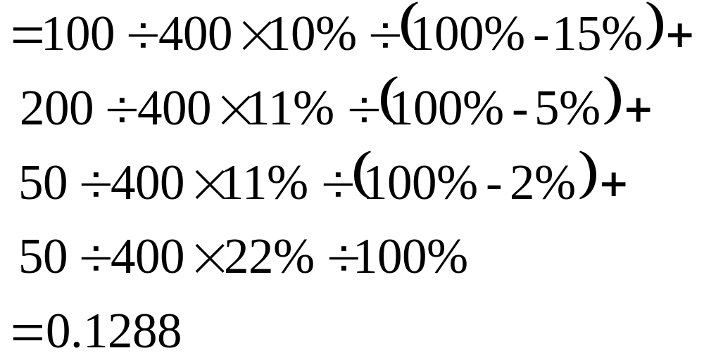
表示成本占可以拿出去投资的钱的比率

Slide 31
Using Marginal Cost to Set Interest Rates on Deposits
Many financial analysts argue that marginal cost, and not weighted average cost, should be used to help price deposits. Frequent changes in interest rates will make average cost a treacherous and unrealistic standard for deposit pricing. If interest rates are declining, the added (marginal) cost of raising new money may fall well below the average cost over all funds raised by the bank. Conversely, if interest rates are on the rise, the marginal cost of today’s new money may substantially exceed the bank’s average cost of funds.

Slide 32
Marginal cost = Change in total cost
= New interest rate × Total funds raised at new rate – Old interest rate × Total funds raised at old rate
Marginal cost rate = Change in total cost /
Additional funds raised

Slide 33
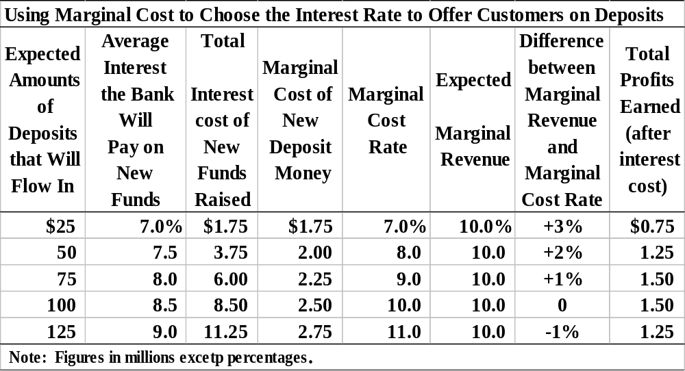

Slide 34
Market-Penetration Deposit Pricing
A pricing method that does not emphasize profits and cost recovery, at least in the short run, is market-penetration deposit pricing. The idea here is to offer high interest rates – usually well above market levels – or charge customer fees well below market standards in order to bring in as many new customers as possible. Market-penetration pricing is a strategy aimed primarily at rapidly growing markets in which a bank is determined to capture the largest possible market share.

Slide 35
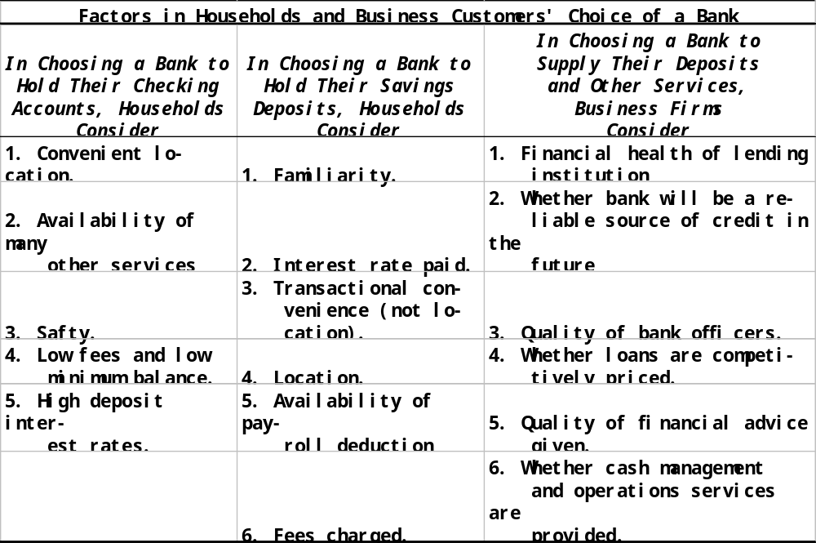
Payroll deduction：税收筹划

Slide 36
conditional pricing存款费用法是有条件定价的一种
Out of the boiling competition came widespread use of deposit fee schedules. This approach is often called conditional pricing because the bank sets up a schedule of fees in which the customer pays a low fee or even no fee if the deposit balance remains above some minimum level, but a higher fee is assessed if the average balance falls below that minimum.

Slide 37
Deposit fee schedules vary deposit prices according to the following factors:
The number of transactions passing through the account. 账户活跃的频次
The average balance held in the account over a designated period. 余额
The maturity of the deposit in days, weeks, or months.期限

Slide 38
Flat-rate pricing
In the method, the depositor’s cost is a fixed charge per check, per time period, or both. Thus, there may be a monthly account maintenance fee of $2, and each check written against that account may cost the customer 10 cents, regardless of the level of account activity.

Slide 39
Free pricing 免费
It refers to the absence of a monthly account maintenance fee or per-transaction charge. Many banks have found free pricing decidedly unprofitable.

Slide 40
Conditional pricing
This approach favors large-denomination deposits, because services are free if the account balance stays above some minimum figure. The following is an example.

Slide 41
Bank A
Regular checking account:
Minimum opening balance $100
If minimum daily balance is:
$600 or more No fee
$300 to $599 $5 per mo.
Less than $300 $10 per mo.
If the depositor’s collected monthly balance averages $1500, there is no fee.
No limit on number of checks written.

Slide 42
Bank A
Regular savings account:
Minimum opening balance $100
Service fees:
If balance falls below $200 $3 per mon.
Balance of $200 or more No fee
Fee for more than two
withdrawals per month $2 per mon.

Slide 43
Bank B
Regular checking account:
Minimum opening balance $100
If minimum daily balance is:
$500 or more No fee
Less than $300 $3.5 per mo.
If checks written or ATM
transaction (debits) exceed
10 per month and balance
is below $500 $0.15 per debit

Slide 44
Bank B
Regular savings account:
Minimum opening balance $100
Service fees:
If balance falls below $100 $2 per mon.
Balance above $100 No fee
Fee for more than three
withdrawals per month $2 per mon.

Slide 45
Bank deposit pricing policy is sensitive to:
The Types of customers each bank plans to serve.
The cost that serving different types of depositors will present to the bank.

Slide 46
Using Upscale Target Pricing
Some banks, particularly in large urban communities, use carefully designed advertising programs to target established professionals (e.g., doctors and lawyers), business owners and managers, and other high-income households with services and service fees that build in high profit margins. Other deposit accounts, especially the low-balance, high-activity ones, may be priced to break even(不赔不赚), or they may be discouraged altogether through higher prices. Often the upscale strategy is blended with a personal banker program in which each upscale customer is assigned a particular bank officer who handles all that customer’s banking needs.

Slide 47
Pricing Deposits Based on the Total Customer Relationship
Related to the idea of courting the bank’s best customers is the notion of pricing deposit according to the number of services the customer uses. Customers who purchase two or more bank services may be granted lower deposit fees or have some fees waived compared to the fees charged customers having only a limited relationship to the bank.The idea is that selling a customer multiple services increases the customer’s dependence on the bank and makes it harder for that customer to go elsewhere because of the strong relationship between customer and bank. Thus, in theory at least, relationship pricing promotes greater customer loyalty and makes the customer less sensitive to the interest rates offered on deposits or the prices posted on other banking services by competing financial-service firms.银行和客户关系更强时，银行可以给客户更多存款利率，因为银行可以从其他地方赚钱

Slide 48
Using Deposit Pricing to Achieve Bank Goals
Bankers have learned in recent years that deposit pricing can be used to shape the kind of customer base each bank serves. Changing deposit prices affects not only the spread between bank loan rates and deposit rates but also customer balances and deposit mix decisions, which in turn influence bank growth and profit margins. More over, the smaller the difference between loan and deposit interest rates, the greater the sensitivity of bank profit margins to changes in deposit prices.
Deposit pricing is best used to protect and increase bank profitability, rather than to simply add more customers and take market share away from competitors.

Slide 49
Bank’s interest rate
Spread between
Loans and deposits
Changes in
Deposit prices
Bank profit
margin over
costs and the
growth of
bank deposits
Customer decisions
On amount and mix
Of deposit holdings
Bank deposit
volume and
composition

